Slide 1
SAP Cloud Connector

Slide 2
What is Cloud Connector
The Cloud Connector
Serves as a link between SAP Cloud Platform applications and on-premise systems.
Combines an easy setup with a clear configuration of the systems that are exposed to the SAP Cloud Platform.
Allows the usage existing on-premise assets without exposing the entire internal landscape.
Acts as a reverse invoke proxy between the on-premise network and SAP Cloud Platform.
Lets you use the features that are required for business-critical enterprise scenarios.
Recovers broken connections automatically.
Provides audit logging of inbound traffic and configuration changes.
Can be run in a high-availability setup.

Slide 3
Advantages
Compared to the approach of opening ports in the firewall and using reverse proxies in the DMZ to establish access to on-premise systems, the Cloud Connector offers the following benefits:
You don't need to configure the on-premise firewall to allow external access from SAP Cloud Platform to internal systems. For allowed outbound connections, no modifications are required.
The Cloud Connector supports HTTP as well as additional protocols. For example, the RFC protocol supports native access to ABAP systems by invoking function modules.
You can use the Cloud Connector to connect on-premise databases or BI tools to SAP HANA databases in the cloud.
The Cloud Connector lets you propagate the identity of cloud users to on-premise systems in a secure way.
Easy installation and configuration, which means that the Cloud Connector comes with a low TCO and is tailored to fit your cloud scenarios.
SAP provides standard support for the Cloud Connector.

Slide 4
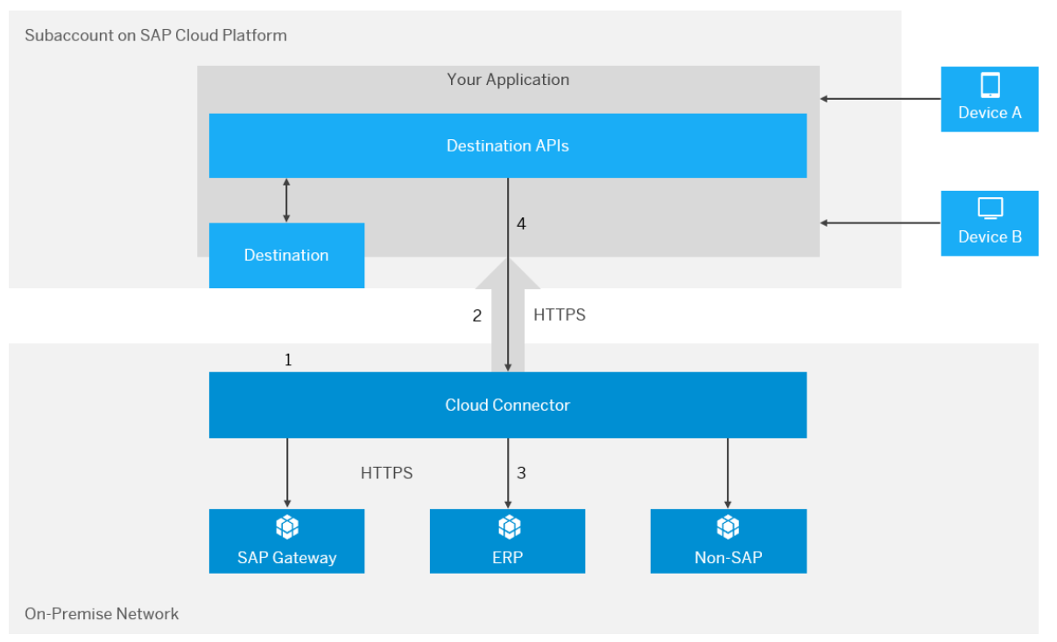
Connecting Cloud Applications to On-Premise Systems

Slide 5
Where Cloud Connector can be used
Environment | Examples
Customer on-premise backend systems | SAP ERP SAP S/4 HANA
SAP Hosting | SAP HANA ENTERPRISE CLOUD
Third-party IaaS providers (hosting) | Amazon Web Services Google Cloud Platform Microsoft Azure

Slide 6
Where Cloud Connector cannot be used
Environment | Examples
SAP SaaS solutions | SAP SuccessFactors SAP Concur SAP Ariba
SAP cloud-based enterprise solutions | SAP S/4HANA Cloud SAP C/4HANA
Third-party PaaS providers | Amazon Web Services Google Cloud Platform Microsoft Azure
Third Party Saas providers | 1. Any custom applications.

Slide 7
Basic Tasks on Cloud Connector
Installation
01
Portable Version & Installer Version
Microsoft Windows & Linux – Both Versions
Mac OS X – Portable Version only
Configuration
02
Administration Logon
Setup Connection Parameters
Establishing SSL Tunnel from cloud connector user to SAP Cloud Platform.
Managing Sub Accounts
03
One Cloud Connector to Multiple Sub Accounts
Sub Account Dashboard
Location

Slide 8
Basic Tasks on Cloud Connector
Installation
01
Portable Version & Installer Version
Microsoft Windows & Linux – Both Versions
Mac OS X – Portable Version only
Portable Version – Advantages
No Installation, download and use
No need of Admin rights or root privileges
Can run multiple instances on same host
Portable Version – Disadvantages
cannot run it in the background as a Windows Service or Linux daemon, Automatic restart is not possible
The portable version does not support an automatic upgrade procedure
Portable versions are meant for non-productive scenarios only
The environment variable JAVA_HOME is relevant when starting the instance, and therefore must be set properly

Slide 9
Basic Tasks on Cloud Connector
Installation
01
Portable Version & Installer Version
Microsoft Windows & Linux – Both Versions
Mac OS X – Portable Version only
Installer Version – Advantages
Easy Upgrades
Automatic restart
Administrator privileged
Secured and can be used for productive environments
No need of JAVA_Home Environment while starting the instance
Can be used in multiple instances.
It is always recommended to use Installer version of the cloud connector for productive environments.

Slide 10
Basic Tasks on Cloud Connector
Configuration
02
Administration Logon
Setup Connection Parameters
Establishing SSL Tunnel from cloud connector user to SAP Cloud Platform.
Pre-requisites
There are few pre-requisites to be done for Successful Installation of Cloud Connector.
Hardware
Software
JDK
Product Availability Matrix
Network

Slide 11
Pre-Requisites for Cloud Connector Installation
Hardware
Software
 | Minimum | Recommended
CPU | Single core 3 GHz, x86-64 architecture compatible | Dual core 2 GHz, x86-64 architecture compatible
Memory (RAM) | 2 GB | 4 GB
Free disk space | 3 GB | 20 GB
Cloud Connector Installation Archive to be downloaded from https://tools.hana.ondemand.com/#cloud
A JDK 7 or 8 must be installed
JDK’s
JDK | Version | Cloud Connector Version
SAP JVM 64-bit (recommended) | 7 | 2.X
 | 8 | 2.72 and higher
Oracle JDK 64-bit | 7 | 2.X
 | 8 | 2.72 and higher

Slide 12
Pre-Requisites for Cloud Connector Installation
Product Availability Matrix
Operating System Version | Architecture | Cloud Connector Version
Windows 7, Windows Server 2008 R2 | x86_64 | 2.x
SUSE Linux Enterprise Server 11, Redhat Enterprise Linux 6 | x86_64 | 2.x
Mac OS X 10.7 (Lion), Mac OS X 10.8 (Mountain Lion) | x86_64 | 2.x
Windows 8.1, Windows Server 2012, Windows Server 2012 R2 | x86_64 | 2.5.1 and higher
SUSE Linux Enterprise Server 12, Redhat Enterprise Linux 7 | x86_64 | 2.5.1 and higher
Mac OS X 10.9 (Mavericks), Mac OS X 10.10 (Yosemite) | x86_64 | 2.5.1 and higher
Windows 10 | x86_64 | 2.7.2 and higher
Mac OS X 10.11 (El Capitan) | x86_64 | 2.8.1 and higher
Windows Server 2016 | x86_64 | 2.9.1 and higher
Windows Server 2019, Mac OS X 10.12 (Sierra), Mac OS X 10.13 (High Sierra), Mac OS X 10.14 (Mojave) | x86_64 | 2.11.3 and higher
SUSE Linux Enterprise Server 15 | x86_64 | 2.12.0 and higher

Slide 13
Pre-Requisites for Cloud Connector Installation
Network
Region (Region Host) | Hosts | IP Addresses
Neo Environment
Europe (Rot)(hana.ondemand.com) | connectivitynotification.hana.ondemand.com | 155.56.210.83
 | connectivitycertsigning.hana.ondemand.com | 155.56.210.43
 | connectivitytunnel.hana.ondemand.com | 155.56.210.84
Europe (Frankfurt)(eu2.hana.ondemand.com) | connectivitynotification.eu2.hana.ondemand.com | 157.133.70.140
 | connectivitycertsigning.eu2.hana.ondemand.com | 157.133.70.132
 | connectivitytunnel.eu2.hana.ondemand.com | 157.133.70.141
Europe (Amsterdam)(eu3.hana.ondemand.com) | connectivitynotification.eu3.hana.ondemand.com | 157.133.141.140
 | connectivitycertsigning.eu3.hana.ondemand.com | 157.133.141.132
 | connectivitytunnel.eu3.hana.ondemand.com | 157.133.141.141
United States East (Ashburn)(us1.hana.ondemand.com) | connectivitynotification.us1.hana.ondemand.com | 65.221.12.40
 | connectivitycertsigning.us1.hana.ondemand.com | 65.221.12.241
 | connectivitytunnel.us1.hana.ondemand.com | 65.221.12.41
United States West (Chandler)(us2.hana.ondemand.com) | connectivitynotification.us2.hana.ondemand.com | 64.95.110.215
 | connectivitycertsigning.us2.hana.ondemand.com | 64.95.110.211
 | connectivitytunnel.us2.hana.ondemand.com | 64.95.110.214

Slide 14
Pre-Requisites for Cloud Connector Installation
Network
Region (Region Host) | Hosts | IP Addresses
Neo Environment
United States (Sterling) (us3.hana.ondemand.com) | connectivitynotification.us3.hana.ondemand.com | 169.145.118.140
 | connectivitycertsigning.us3.hana.ondemand.com | 169.145.118.132
 | connectivitytunnel.us3.hana.ondemand.com | 169.145.118.141
Australia (Sydney)(ap1.hana.ondemand.com) | connectivitynotification.ap1.hana.ondemand.com | Previous: 210.80.140.247 | Current:157.133.97.47
 | connectivitycertsigning.ap1.hana.ondemand.com | Previous: 210.80.140.227 | Current: 157.133.97.27
 | connectivitytunnel.ap1.hana.ondemand.com | Previous: 210.80.140.246 | Current: 157.133.97.46
China (Shanghai)(cn1.hana.ondemand.com | connectivitynotification.cn1.hana.ondemand.com | 157.133.192.140
 | connectivitycertsigning.cn1.hana.ondemand.com | 157.133.192.132
 | connectivitytunnel.cn1.hana.ondemand.com | 157.133.192.141
Japan (Tokyo)(jp1.hana.ondemand.com) | connectivitynotification.jp1.hana.ondemand.com | 157.133.150.140
 | connectivitycertsigning.jp1.hana.ondemand.com | 157.133.150.132
 | connectivitytunnel.jp1.hana.ondemand.com | 157.133.150.141
Canada (Toronto)(ca1.hana.ondemand.com) | connectivitynotification.ca1.hana.ondemand.com | 157.133.54.140
 | connectivitycertsigning.ca1.hana.ondemand.com | 157.133.54.132
 | connectivitytunnel.ca1.hana.ondemand.com | 157.133.54.141

Slide 15
Pre-Requisites for Cloud Connector Installation
Network
Region (Region Host) | Hosts | IP Addresses
Neo Environment
Russia (Moscow)(ru1.hana.ondemand.com) | connectivitynotification.ru1.hana.ondemand.com | 157.133.2.140
 | connectivitycertsigning.ru1.hana.ondemand.com | 157.133.2.132
 | connectivitytunnel.ru1.hana.ondemand.com | 157.133.2.141
Brazil (São Paulo) (br1.hana.ondemand.com) | connectivitynotification.br1.hana.ondemand.com | 157.133.246.140
 | connectivitycertsigning.br1.hana.ondemand.com | 157.133.246.132
 | connectivitytunnel.br1.hana.ondemand.com | 157.133.246.141
UAE (Dubai)(ae1.hana.ondemand.com) | connectivitynotification.ae1.hana.ondemand.com | 157.133.85.140
 | connectivitycertsigning.ae1.hana.ondemand.com | 157.133.85.132
 | connectivitytunnel.ae1.hana.ondemand.com | 157.133.85.141
KSA (Riyadh)(sa1.hana.ondemand.com) | connectivitynotification.sa1.hana.ondemand.com | 157.133.93.140
 | connectivitycertsigning.sa1.hana.ondemand.com | 157.133.93.132
 | connectivitytunnel.sa1.hana.ondemand.com | 157.133.93.141

Slide 16
Basic Tasks on Cloud Connector
Managing Sub Accounts
03
One Cloud Connector to Multiple Sub Accounts
Sub Account Dashboard
Location
PRE-REQUISITES
On Cloud Foundry
The subaccount user that you use for initial setup must be a member of the global account that the subaccount belongs to.
Assign the user as Security Administrator.
On Neo Environment
The subaccount user that you use for initial setup must be assigned to the Cloud Connector Admin or Administrator role.
Assign the user to a custom role that includes the permission manageSCCTunnels

Slide 17
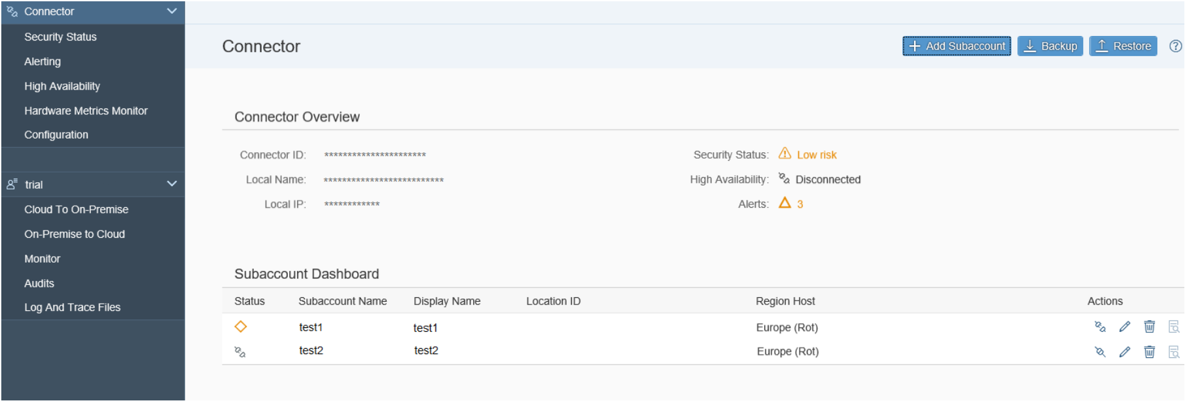
Basic Tasks on Cloud Connector
Managing Sub Accounts
03
One Cloud Connector to Multiple Sub Accounts
Sub Account Dashboard
Location
Sub Account Dashboard
Allows the user to check the status of all sub accounts managed by the cloud connector at a glance
Allows the user to connect or disconnect the sub accounts

Slide 18
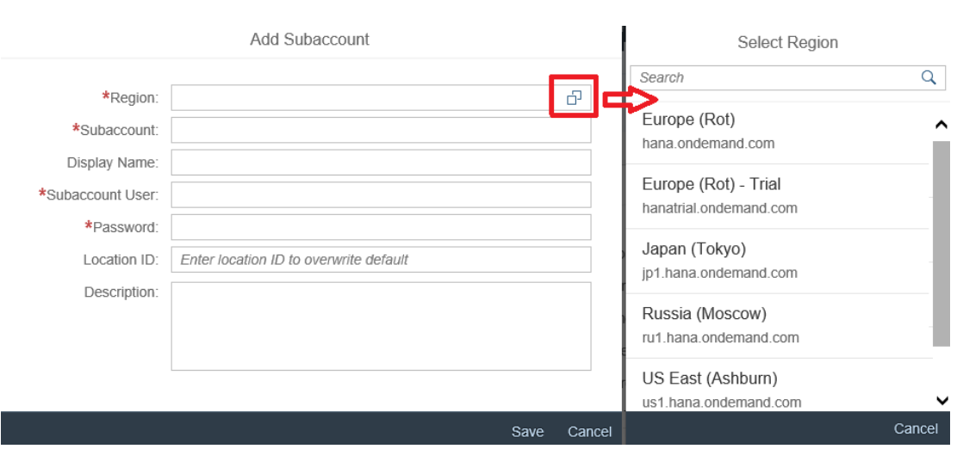
Basic Tasks on Cloud Connector
Managing Sub Accounts
03
One Cloud Connector to Multiple Sub Accounts
Sub Account Dashboard
Location
Location
Allows User to uniquely identify the Cloud connector from a list of cloud connectors.
Differentiator for identifying the environments

Slide 19
Session Summary
Cloud Connector is used to establish a secured connection between the cloud application and on premise system through a secured tunnel.
Acts as a reverse proxy
Can be used to connect,
CPI and On-premise ERP
CPI and PO.
Multiple Sub Accounts can be connected to Cloud Connector
Location ID uniquely identifies the Cloud connector.

